Slide 1
NLP & Deep Learning (Transformers)
Attention is all what you need

Slide 2
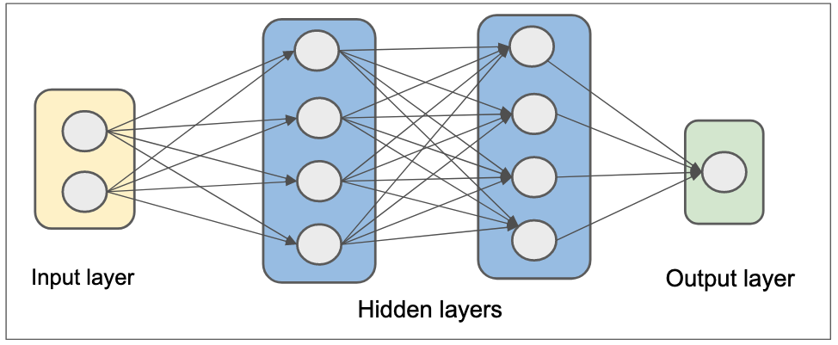
MLP

Slide 3
DNN
A type of artificial neural network that has multiple hidden layers between the input and output layers
usally has more than 5 layers
Capable of learning complex patterns in data by transforming inputs step by step through the layers

Slide 4
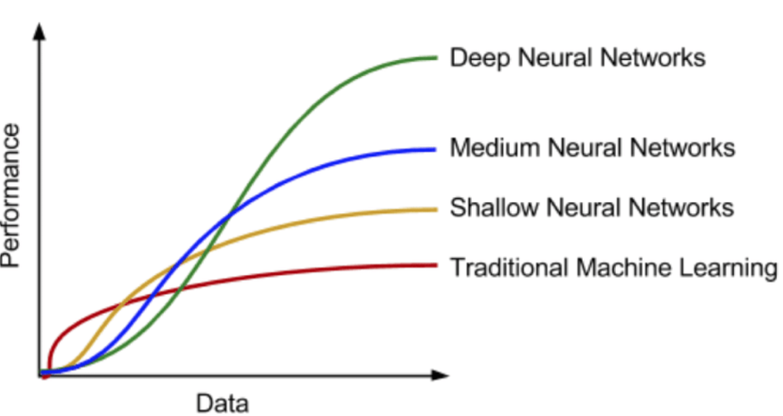
data vs perfomance with DNN

Slide 5
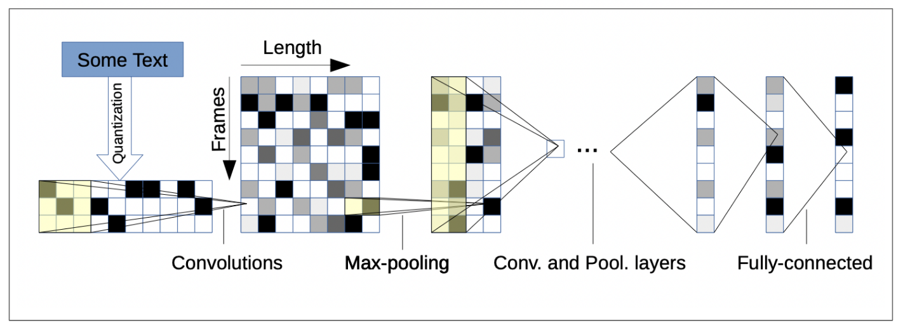
CNN

Slide 6
RNNs
RNNs are a type of neural network designed for sequential data, such as time series or natural language.
They have loops in their architecture, allowing information to persist. This means they can use previous inputs to influence the current output.
RNNs process sequences one element at a time, maintaining a hidden state that captures information about previous elements.
For example, in a sentence, the RNN would take one word, update its hidden state, and then take the next word, continuing this process.

Slide 7
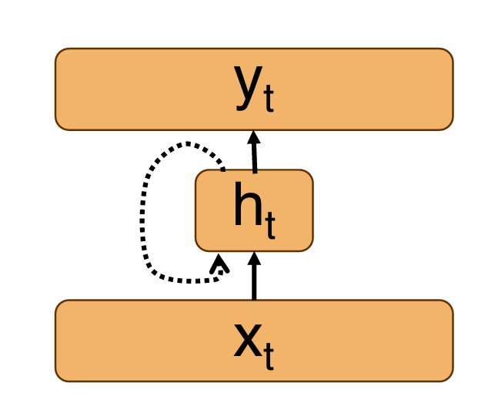
RNN Architecture
Input: w1 → w2 → w3 → ... → wn
↓ ↓ ↓
[RNN] → [RNN] → [RNN]
↑ ↑ ↑
Output: y1, y2, y3, ..., yn

Slide 8
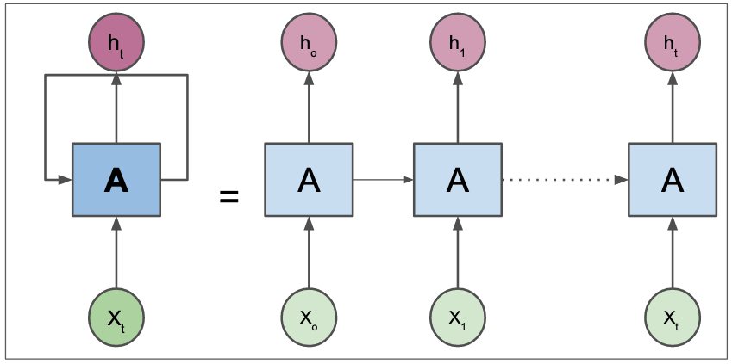
RNN

Slide 9
Limitations of RNNs
Vanishing Gradient Problem: As sequences get longer, the gradients used for training can become very small, making it hard for the network to learn long-range dependencies.
Sequential Processing: RNNs process data sequentially, which can be slow and inefficient, especially for long sequences.

Slide 10
Encoder-Decoder Architecture
This architecture is commonly used for tasks like machine translation.
It consists of two main components: the encoder, which processes the input sequence, and the decoder, which generates the output sequence.
The encoder takes the entire input sequence and compresses it into a fixed-size context vector (a summary of the input).
The decoder then takes this context vector and generates the output sequence, one element at a time.

Slide 11
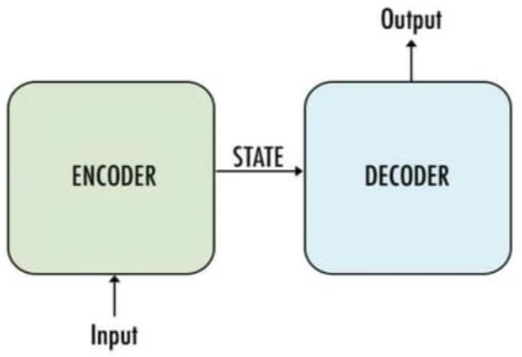
Encoder-Decoder Architecture
Input Sequence: w1 → w2 → w3 → ... → wn
↓
[Encoder]
↓
Context Vector (C)
↓
[Decoder]
↓
Output Sequence: y1 → y2 → y3 → ... → ym

Slide 12
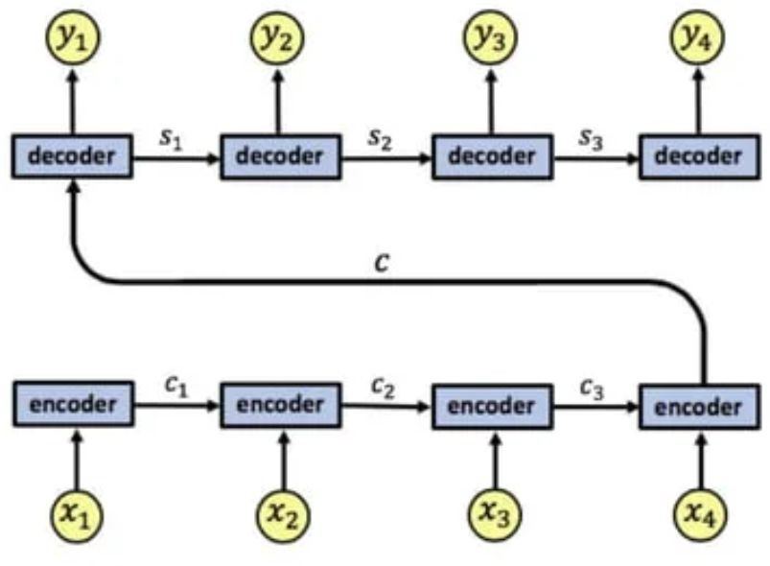
Encoder-Decoder Architecture

Slide 13
Limitations of Encoder-Decoder
The fixed-size context vector can be a bottleneck, especially for long input sequences, as it may not capture all necessary information.
Like RNNs, this architecture also suffers from the vanishing gradient problem.

Slide 14
Transformers
Transformers are a type of neural network architecture introduced in the paper "Attention is All You Need" by Vaswani et al. in 2017.
They are designed to handle sequential data but do not rely on recurrence.

Slide 15
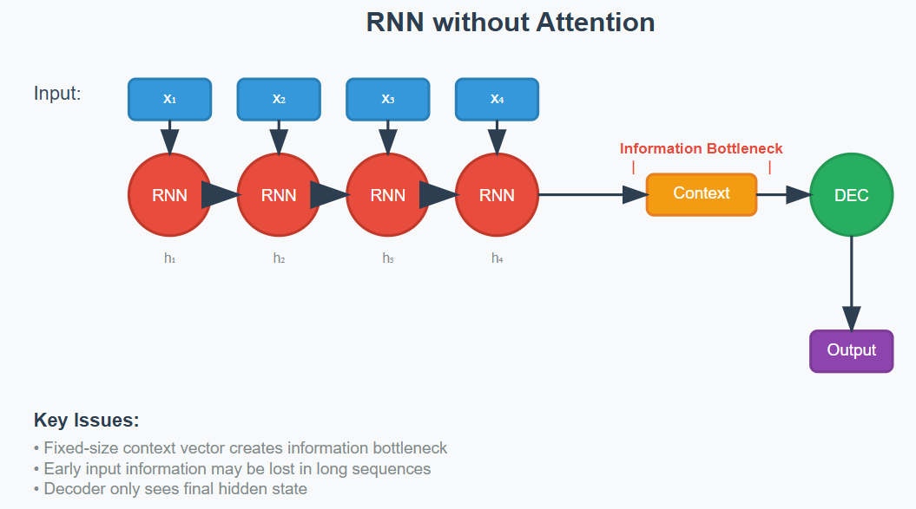

Slide 16
Key Components of Transformers
Attention:
Self-Attention Mechanism: This allows the model to weigh the importance of different words in a sequence when encoding them. Each word can attend to every other word, capturing relationships regardless of their distance in the sequence.
Multi-Head Attention: This allows the model to focus on different parts of the sequence simultaneously, enhancing its ability to capture complex relationships.
Positional Encoding: Since transformers do not process data sequentially, they use positional encodings to give the model information about the position of each word in the sequence.
Feed-Forward Neural Networks: After the attention mechanism, the output is passed through feed-forward networks for further processing.

Slide 17
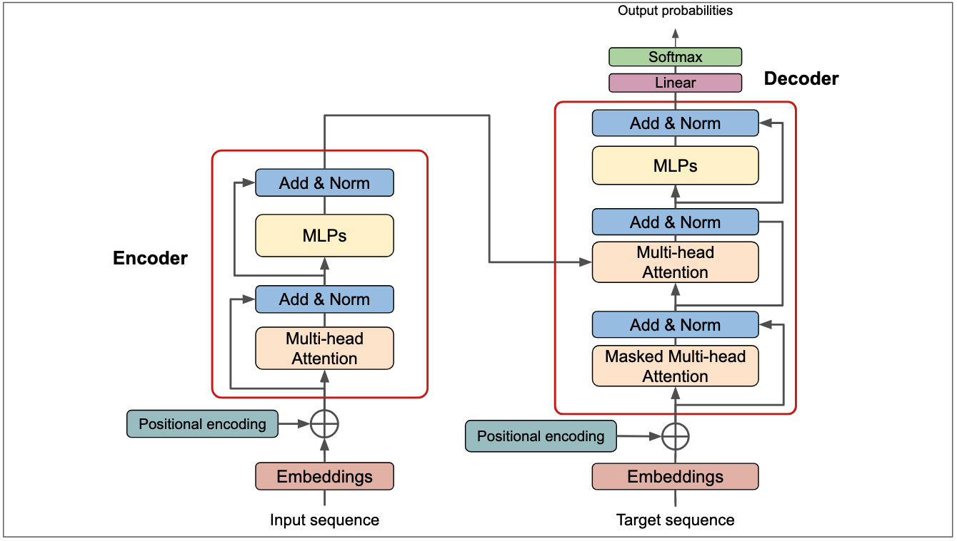
Transformer

Slide 18
Self-Attention Mechanism
Input: w1 w2 w3
| | |
↓ ↓ ↓
Attention Scores:
w1 → [0.1, 0.7, 0.2]
w2 → [0.3, 0.4, 0.3]
w3 → [0.5, 0.2, 0.3]

Slide 19
Types of Attentions
Attention Type | Description | Use Cases
Self-Attention | Each word attends to all others in the sequence, including itself. | Used in both encoder and decoder (e.g., BERT, GPT).
Scaled Dot-Product Attention | Dot-products scaled by the square root of the query dimension to prevent large gradients. | Standard in multi-head attention.
Multi-Head Attention | Parallel self-attention layers to capture different context features. | Core of transformer models.
Cross-Attention | Queries from one sequence attend to another (e.g., decoder attending to encoder outputs). | Used in machine translation.
Sparse Attention | Focuses only on a subset of tokens to reduce computation. | Long-sequence models (e.g., Longformer).
Global Attention | Certain tokens access the entire sequence, while others attend locally. | Mixed context models (e.g., Longformer).
Linearized Attention | Approximates full attention with linear complexity. | Efficient for long sequences (e.g., Linformer).
Memory-Augmented Attention | Uses external memory to store past representations for long-term dependencies. | Long-term memory tasks (e.g., Transformer-XL).

Slide 20
Advantages of Transformers
Parallelization: Unlike RNNs, transformers can process all words in a sequence simultaneously, making them much faster and more efficient.
Long-Range Dependencies: The self-attention mechanism allows transformers to capture long-range dependencies effectively, overcoming the limitations of RNNs and fixed-size context vectors.

Slide 21
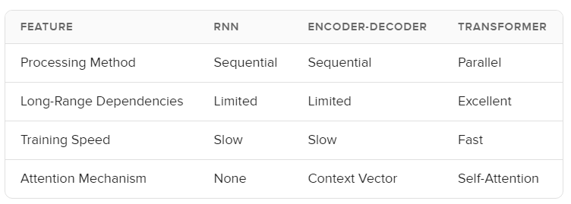
Comparison

Slide 22
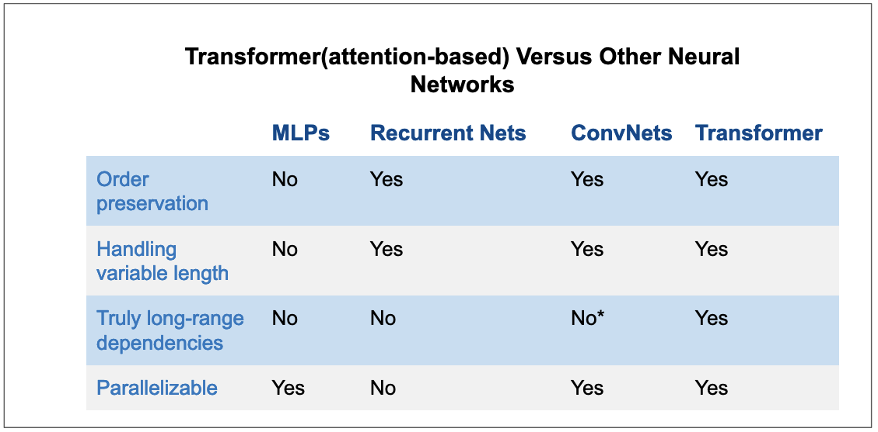

Slide 23
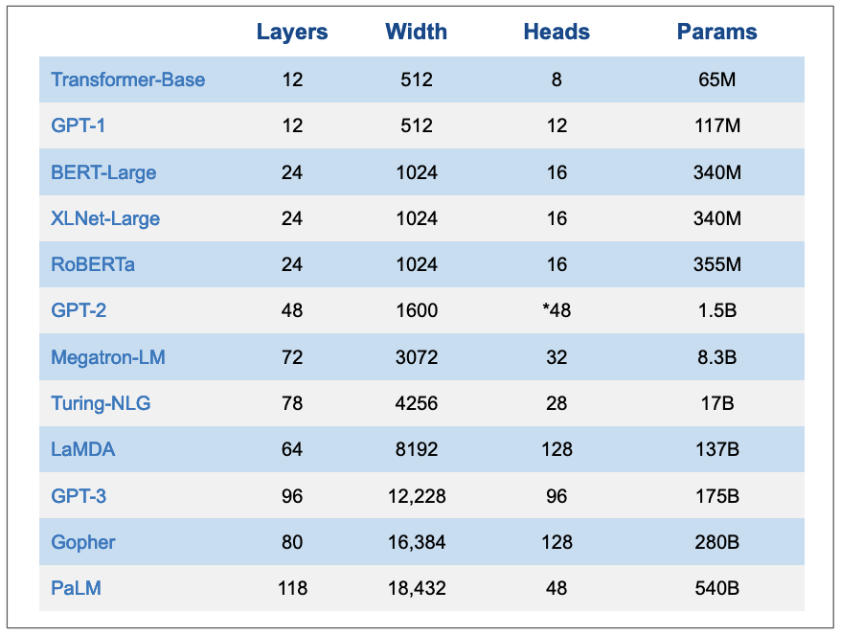

Slide 24
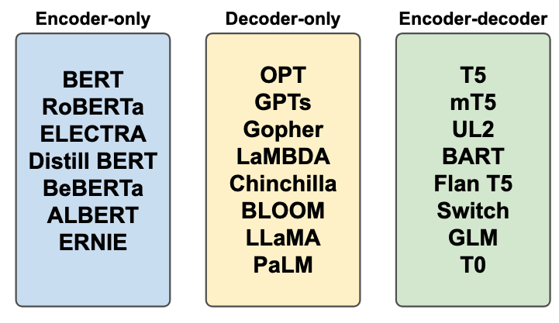
Notes:
Vertical LLMs
Most of LLMs that we outlined above are typically referred to as foundational or frontier LLMs. Foundational models are typically trained on massive amount of data with self-supervision and they can be fine-tuned to a wide range of downstream tasks(Bommasani et al. 2022).
Vertical LLMs are a class of LLMs that are adapted to specific applications. Foundational LLMs can generalize to simple tasks like sentiment analysis but they don’t perform well on complex tasks or tasks that require a domain expertize. For example, a foundational LLM is unlikely to perform well on medical question answering task because it doesn’t have expertize in medicine. More examples: a foundational LLM is unlikely to perform well on legal question answering task because it doesn’t have expertize in law. This is also true in other fields such as finance, physics, chemistry, etc…Vertical LLMs are designed to address this issue. They are trained on a specific domain and they can perform well on tasks that require expertize in that domain. Foundational models aim to be generalists but most of the time, we care about models that can do one thing very well.

Slide 25
Encoder only, decoder only, encoder - decoder I/o

Slide 26
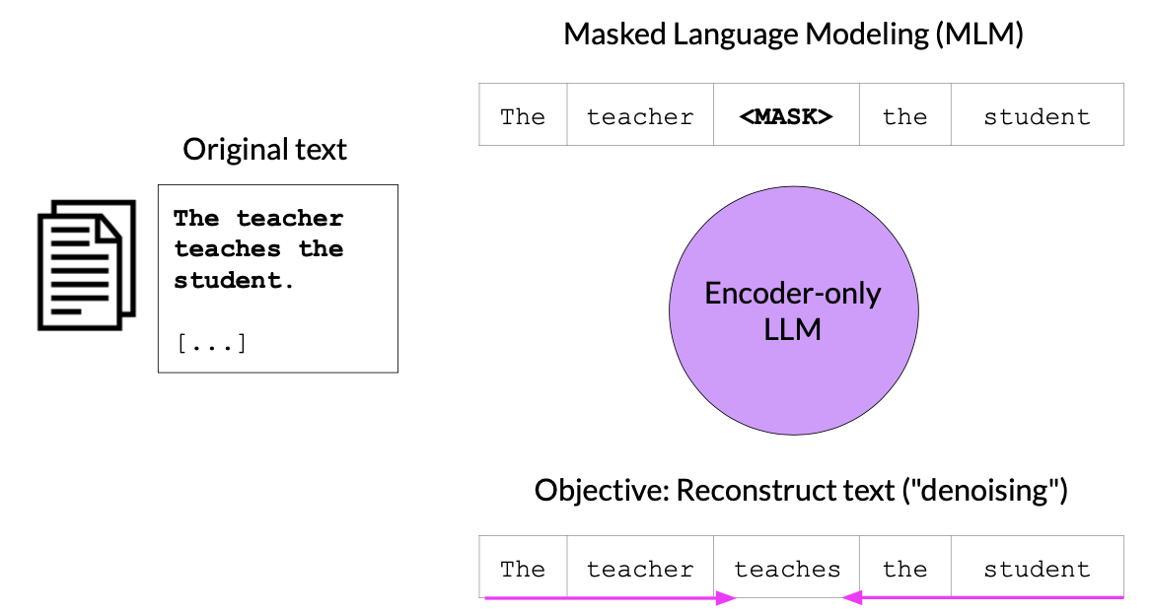
Encoder Models
Usecases : Sentiment Analysis, Named Entity Classification, etc.
Model Ex. : BERT, RoBERTa, etc

Slide 27
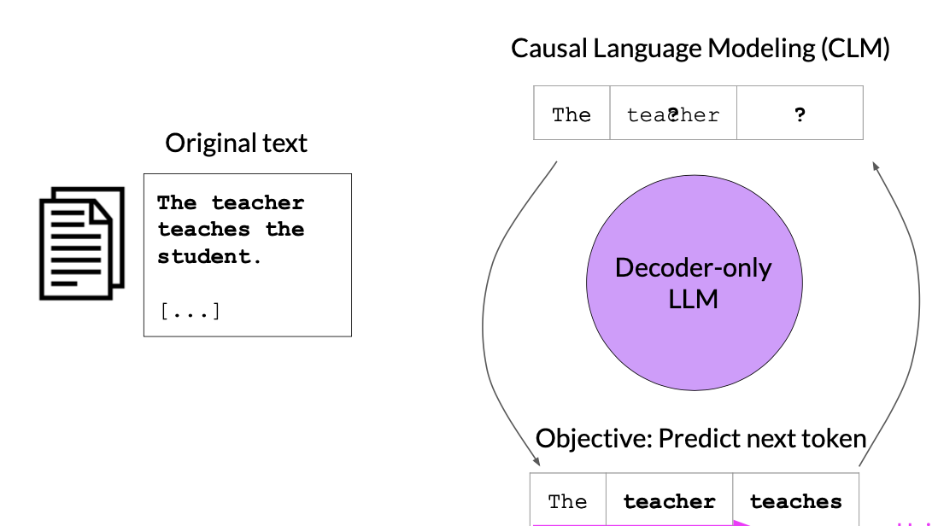
Decoder Models
Usecases : Text Generation, etc
Model Ex : GPT, BLOOM, etc

Slide 28
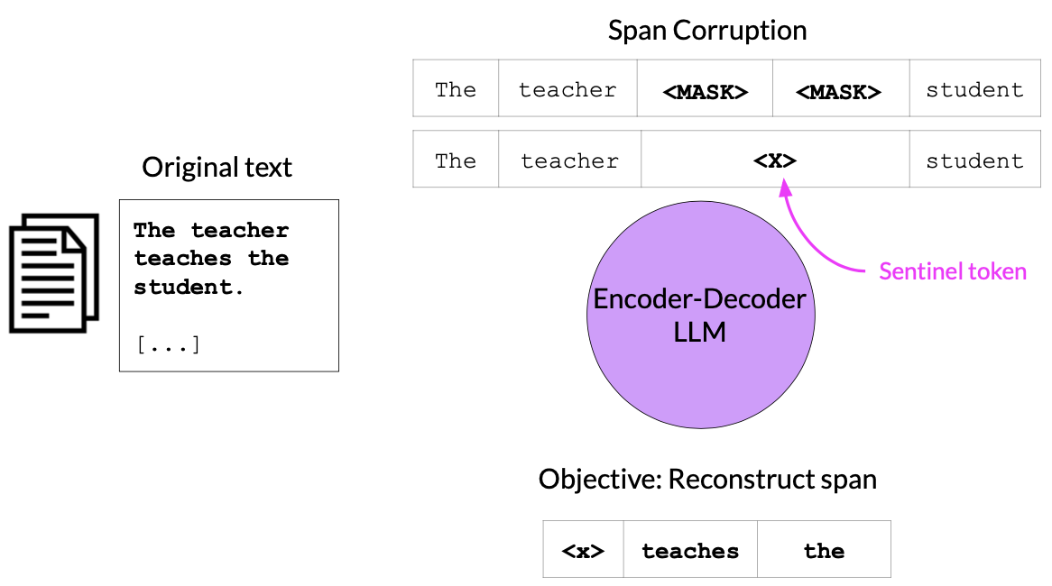
Encoder-Decoder Models
Usecases : Translation, Text Summarization, Question & Answering etc.
Model Ex : T5, BART, etc

Slide 29
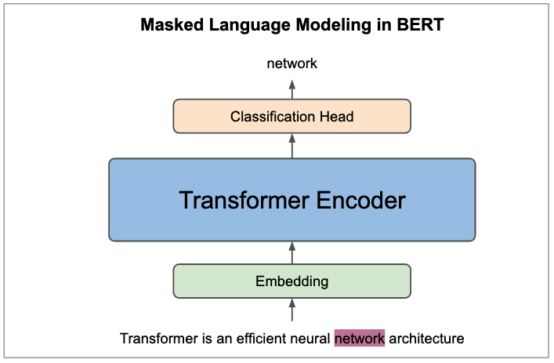
BERT (Bidirectional Encoder Representations from Transformers)

Slide 30
What is BERT
BERT is a method of pre-training language representations, meaning it is a general-purpose model trained on a large text corpus (e.g., Wikipedia). This pre-trained model is then used for downstream NLP tasks such as question answering.
BERT is the first unsupervised, deeply bidirectional system for pre-training NLP.
Unsupervised here means that BERT was trained using only a plaintext corpus (no labeled data), which is important because there is an enormous amount of publicly available plain text data in many languages on the web.

Slide 31
BERT
- BERT (Bidirectional Encoder Representations from Transformers):
- A language model developed by Google in 2018 that significantly improved performance in Natural Language Processing (NLP).
- The BERT method was adapted to the French language in 2019 with two models:
1. CamemBERT: Pre-trained on a corpus of 138 GB of text.
2. FlauBERT: Pre-trained on a corpus of 71 GB of text.

Slide 32
BERT
BERT has also been adapted for the Italian language with models similar to CamemBERT and FlauBERT, aimed at enhancing performance for Italian-specific Natural Language Processing (NLP) tasks. Two of the prominent models are:
AlBERTo: Developed by the Digital Humanities research group at the University of Bari Aldo Moro, this model is pre-trained on Italian social media data (tweets) and is specifically tuned for sentiment analysis and other tasks involving informal text.
Italian BERT (GilBERTo): This version of BERT is pre-trained on a large Italian corpus from various sources, such as news articles, Wikipedia, and legal texts. It performs well across multiple NLP tasks in Italian.
Both models are fine-tuned for Italian text, helping to improve tasks such as text classification, named entity recognition (NER), and question-answering in Italian.

Slide 33
BERT masked language modeling (MLM)
Contextualization: each word is contextualized by the words to its left (or right). This indicates that the model processes the sentence in both directions to understand the meaning of words.
Masking: About 15% of the words in the input sequence are randomly masked, represented by placeholders like [MASK1] and [MASK2]. The model then tries to predict what the masked words are based on the context provided by the surrounding words.
Deep Bidirectional Transformer Encoder: The input sequence is fed into a bidirectional Transformer encoder, which processes the words in both directions (left-to-right and right-to-left) to capture contextual information. After this, the model predicts the masked words.
Example:
Input: "the man went to the [MASK1] . he bought a [MASK2] of milk."
Labels (the correct words for the masked tokens): [MASK1] = store, [MASK2] = gallon.
This approach is used for training language models to better understand context and relationships between words in a sentence

Slide 34
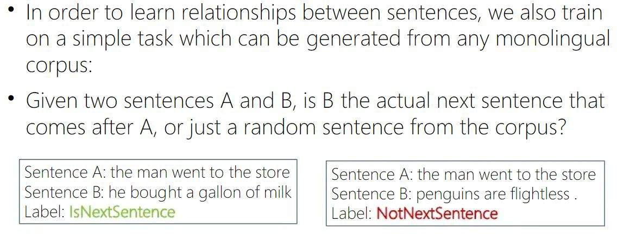
BERT

Slide 35
(Text-to-Text Transfer Transformer)
T5

Slide 36
T5
T5 is an encoder-decoder model pre-trained on a multi-task mixture of unsupervised and supervised tasks and for which each task is converted into a text-to-text format.
T5 works well on a variety of tasks out-of-the-box by prepending a different prefix to the input corresponding to each task.
Example:
for translation: translate English to German: ...,
for summarization: summarize: ....

Slide 37
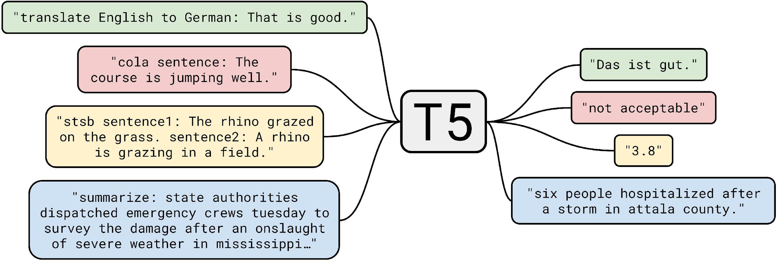
T5 (Text-to-Text Transfer Transformer)

Slide 38
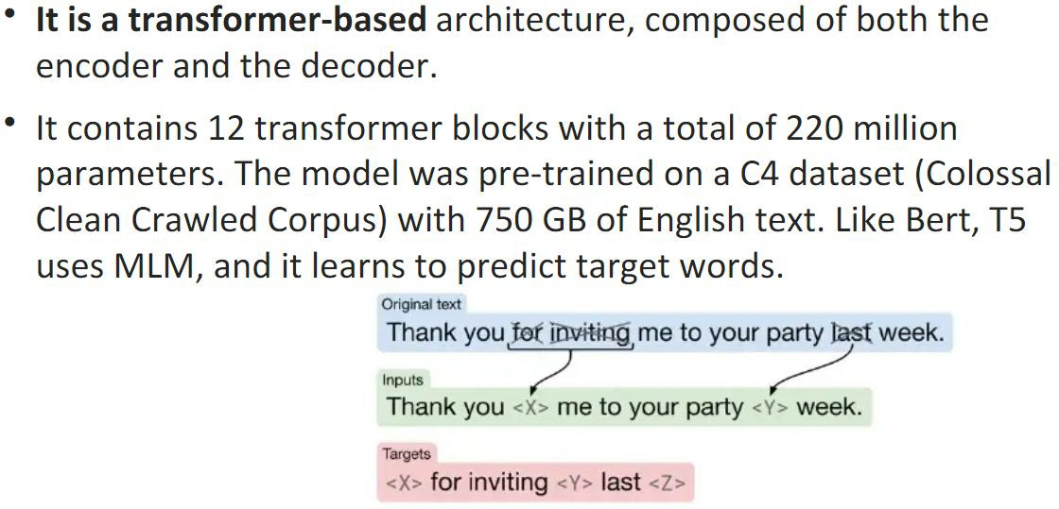
T5

Slide 39
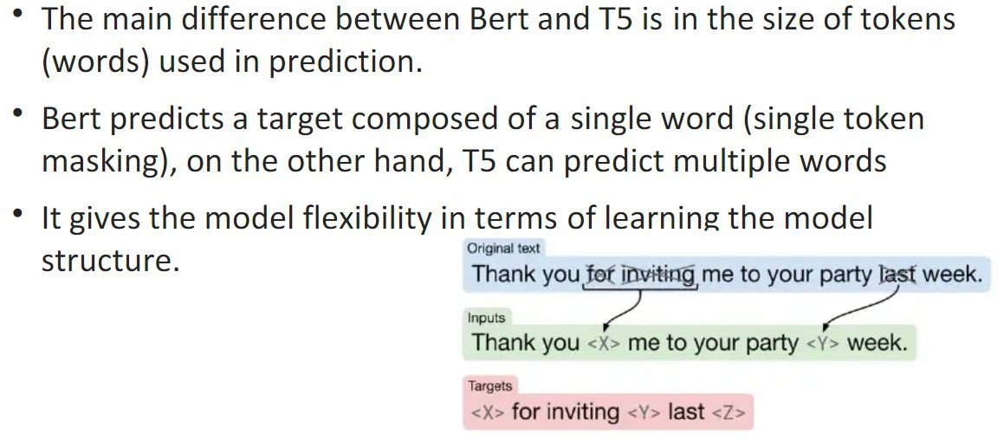
T5 vs BERT

Slide 40
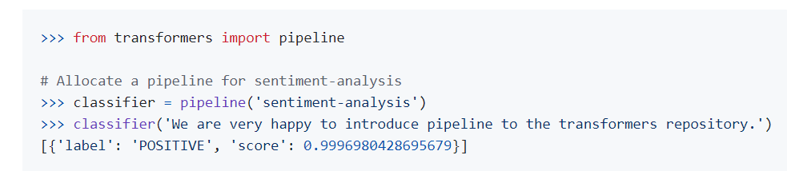
How to use transformers

Slide 41
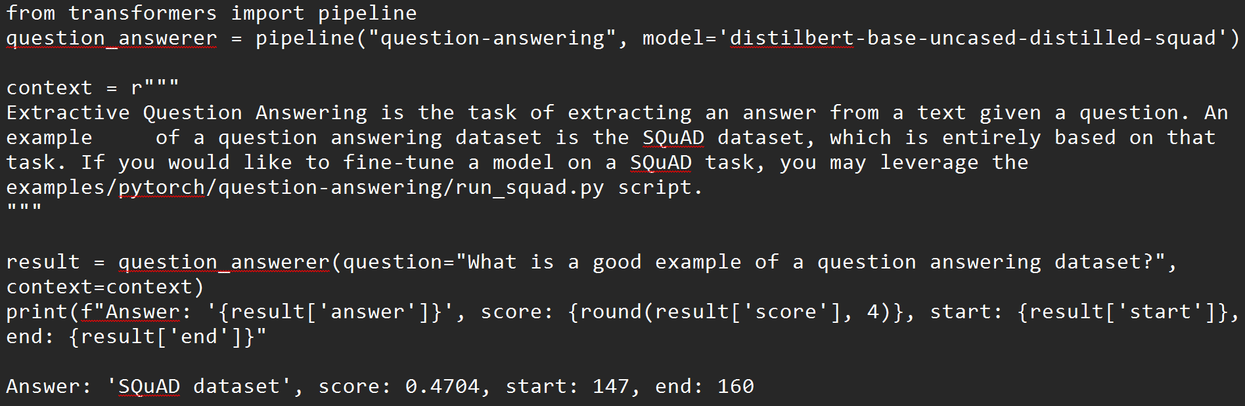
How to use transformers

Slide 42


QA

